Slide 1

Score-based Diffusion Model for Unpaired Virtual Histology Staining
Anran Liu^{1*}, Xiaofei Wang^{2*}, Jing Cai^{1✉️}, Chao Li^{2,3,4✉️}
¹ Department of Health Technology and Informatics, Hong Kong Polytechnic University, China
² Department of Clinical Neurosciences, University of Cambridge, UK
³ School of Science and Engineering, University of Dundee, UK
⁴ Department of Applied Mathematics and Theoretical Physics, University of Cambridge, UK

Slide 2
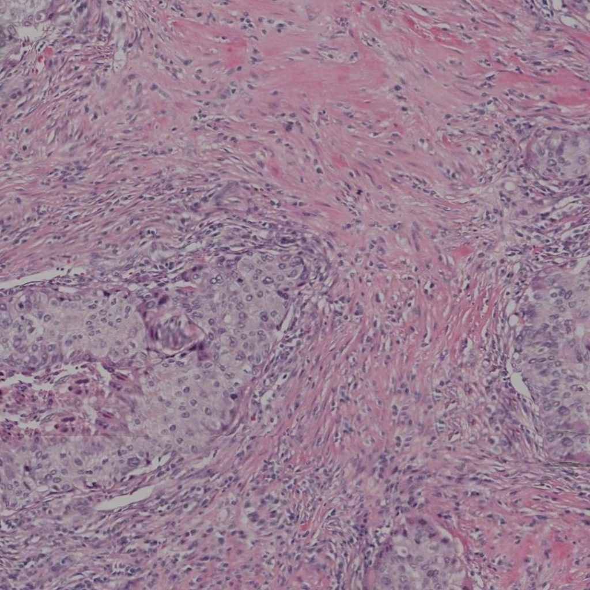
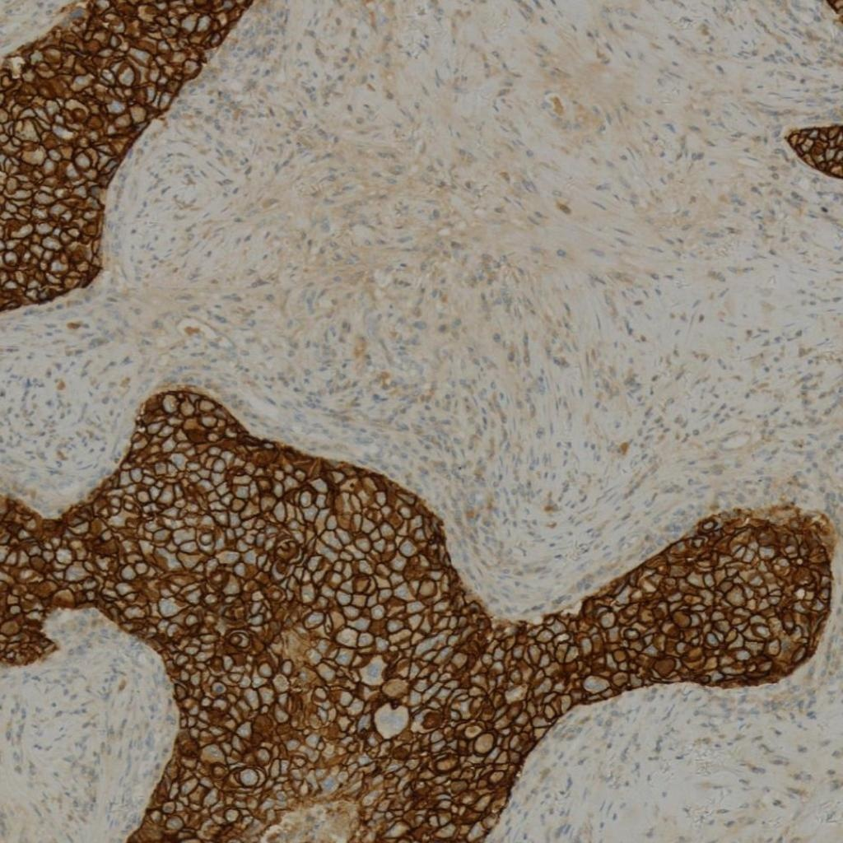
Background & Motivation
H&E Staining
IHC Staining
Most common diagnostic practice
Visualizes general tissue morphology
Limitation: Lacks specificity for diagnostic markers
Cannot provide protein expression information
Provides protein-targeted staining
Offers sensitive diagnostic markers
Limitations: Laborious and time-intensive
Limited by tissue availability and antibody specificity
Virtual Staining Solution
Computationally translate H&E images to IHC counterparts while preserving tissue structure, enabling efficient IHC generation without physical staining processes.

Slide 3

Key Challenges
Challenge 1: Style-Structure Disentanglement
Effective decomposition of staining style and tissue structure across H&E and IHC modalities
Challenge 2: Controllable Staining Process
Adaptable staining generation for diverse tissue types and protein markers
Challenge 3: Structural Consistency
Maintaining rigorous structural alignment despite non-pixel-aligned nature of H&E-IHC datasets
Limitations of Existing Methods
GAN-based: Mode collapse, training instability, entangled generation
Previous Diffusion: Assume strict pixel-wise alignment, high computational complexity

Slide 4
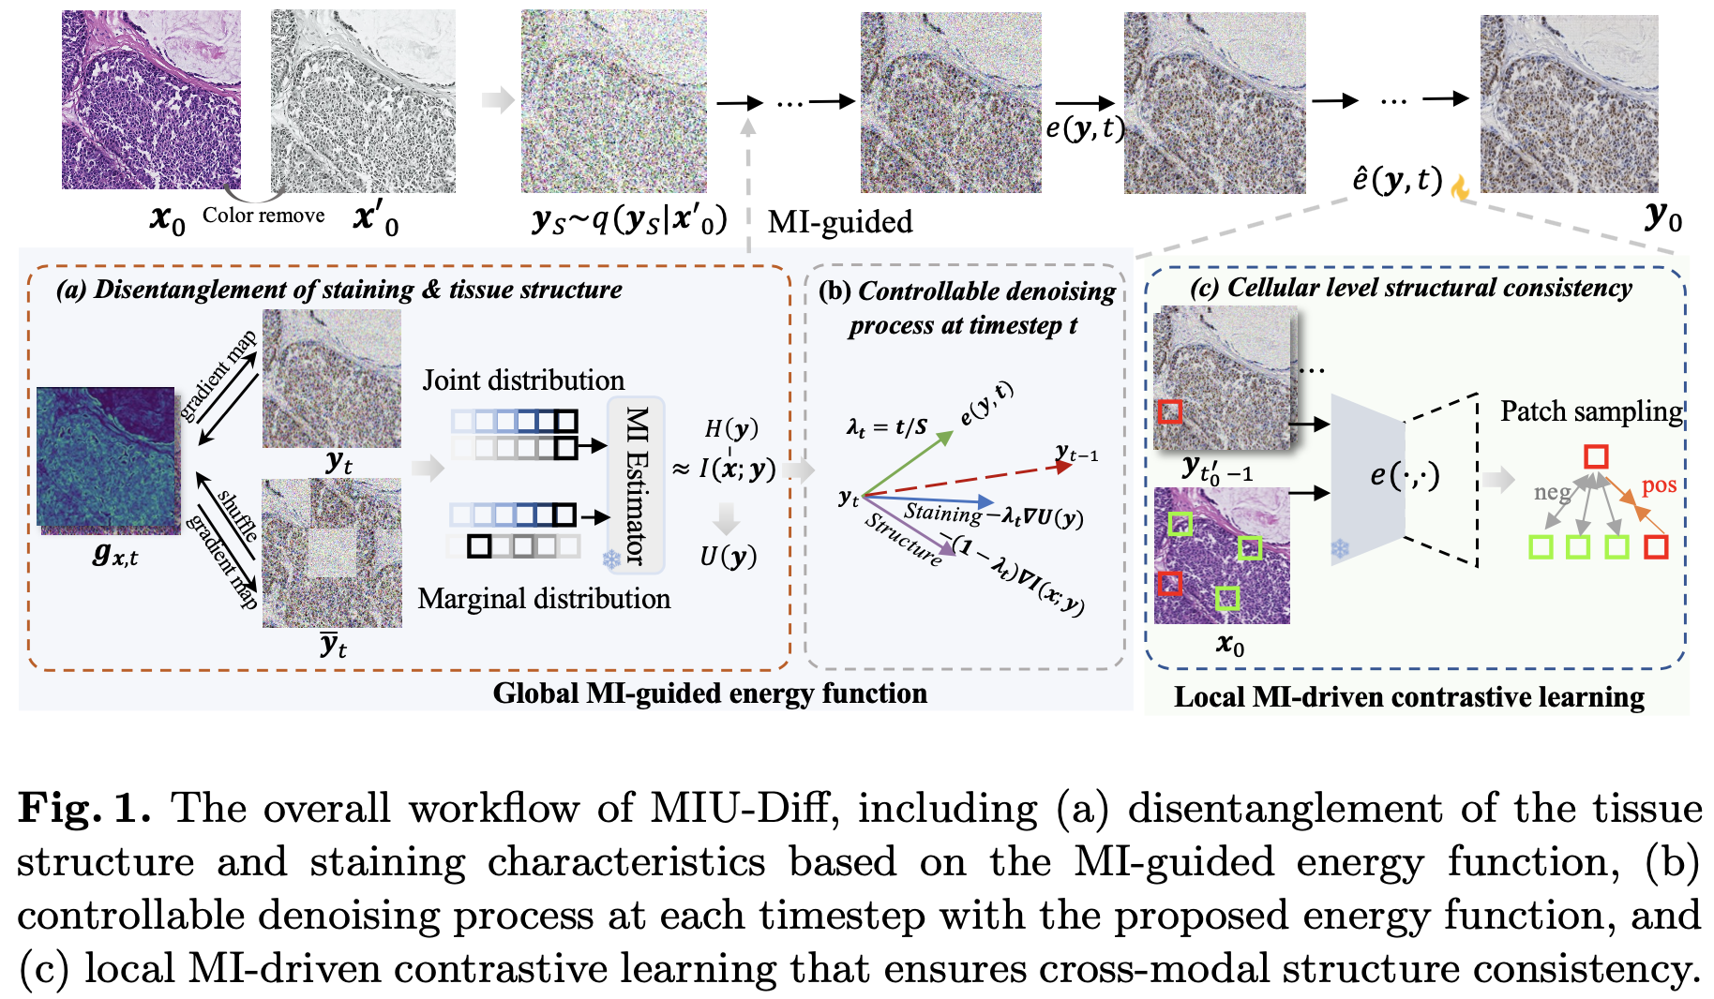
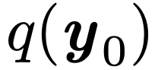
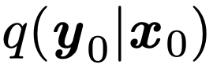
Methodology
Stage 1: Pretrain the IHC distribution
Stage 2: Learn from H&E to unpaired IHC

Slide 5
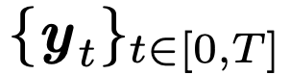
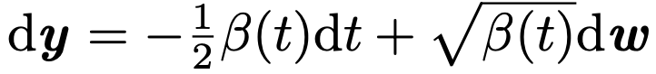
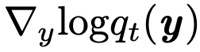
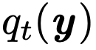
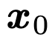
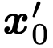
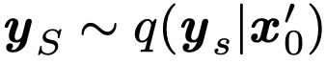
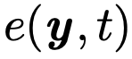
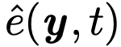
Methodology
Stage 1: The forward diffusion process follows a forward SDE
The reverse process can be modeled through a variance-preserving (VP)-SDE
≈
marginal distribution at t
Stage 2:
Remove color
, noisy image
with starting point S
The reverse process
MI-guided energy function
is optimized to obtain through patch-level contrastive learning

Slide 6
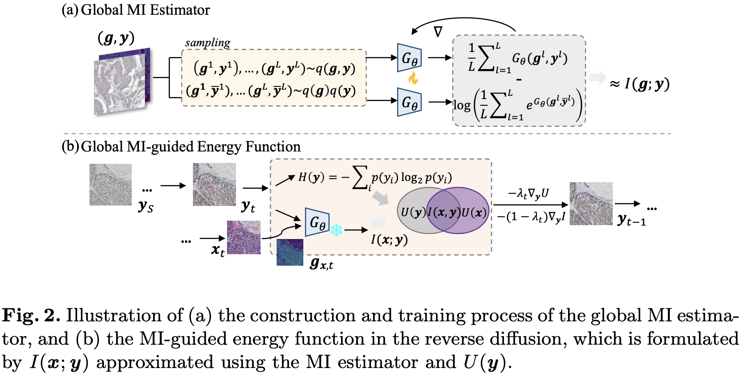
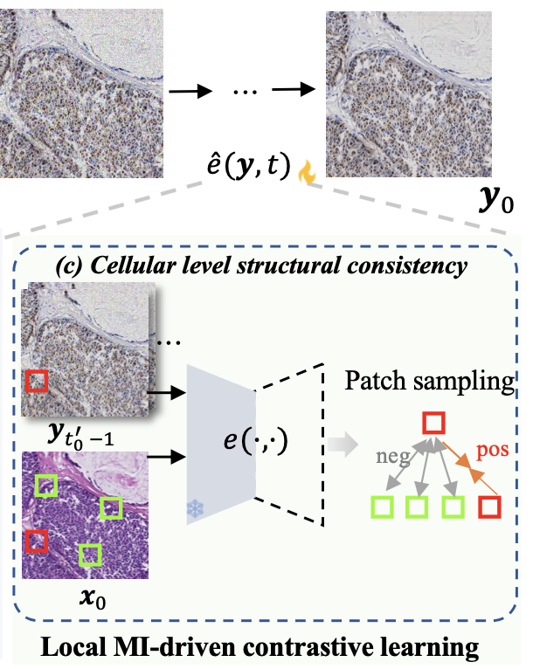
Methodology
MI-guided disentanglement
T →
Local MI-driven contrastive learning
t‘₀→

Slide 7
Experimental Setup
Datasets
BCI Dataset: Breast cancer IHC
3,498/437/438 train/val/test H&E-HER2 pairs
MIST Dataset: Multi-IHC for breast cancer
HER2: 4,513/564/563 pairs
Ki67: 4,288/536/537 pairs
Patch size: 1024×1024 → 256×256
Implementation Details
Hardware: 2×Tesla V100 32GB GPUs
Training: 40k iterations, batch size 4
Optimizer: AdamW, lr = 1×10⁻⁴
Timesteps: N = 300, t'₀ = 40
Framework: PyTorch
Evaluation Metrics
PSNR: Objective image quality assessment
VIF: Visual Information Fidelity (information preservation)
Hist: Histogram correlation (color matching)
IOD: Integrated Optical Density deviation (clinical relevance)

Slide 8
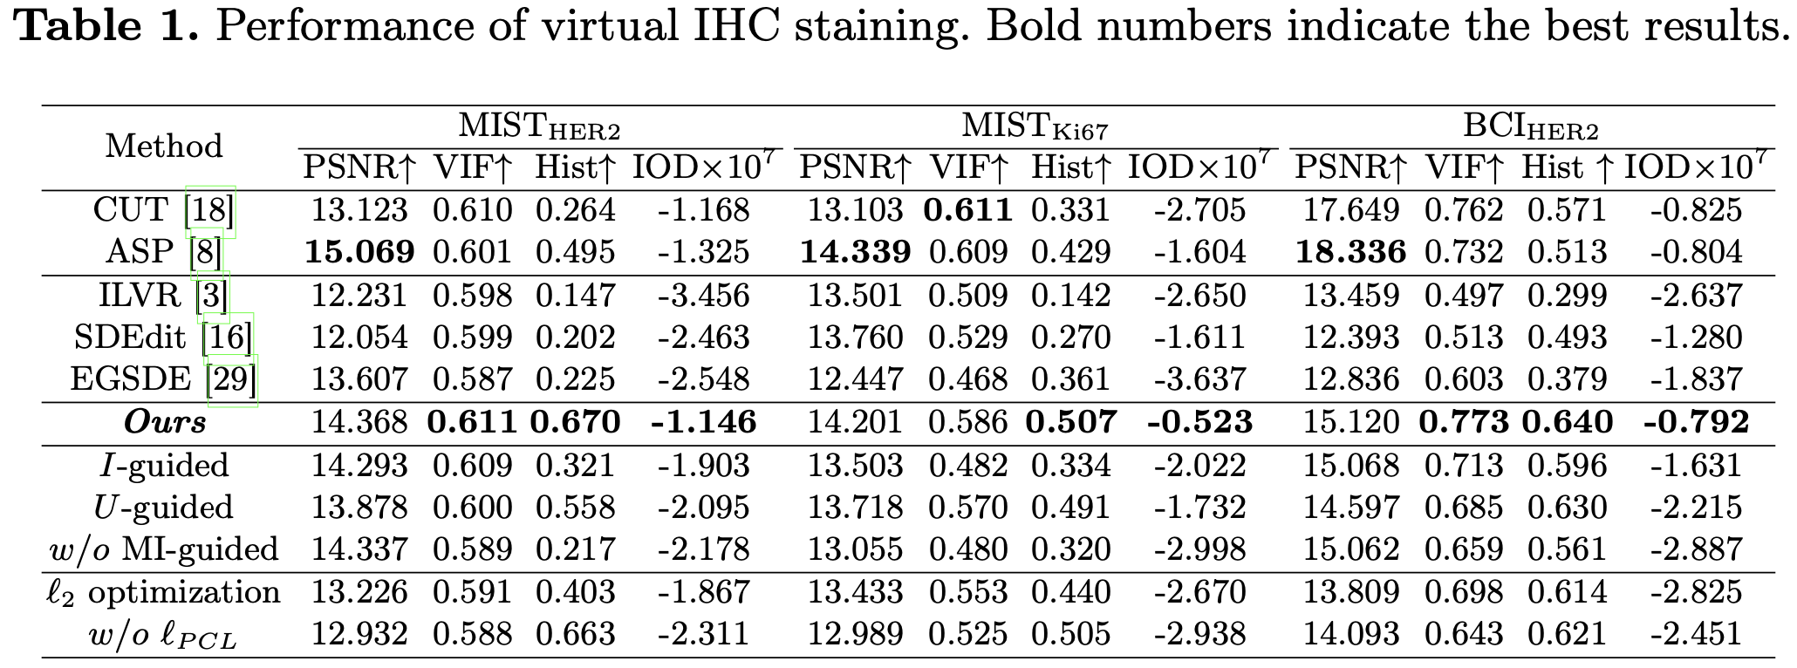
Experimental Results

Slide 9
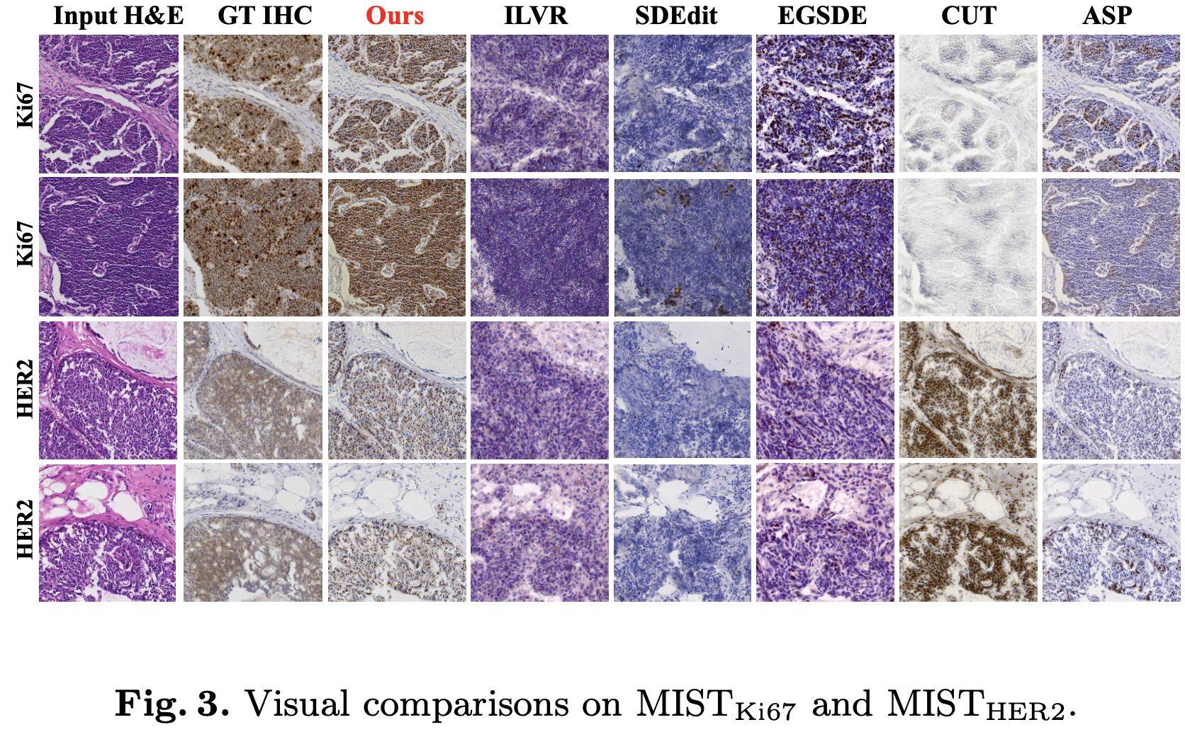
Experimental Results

Slide 10
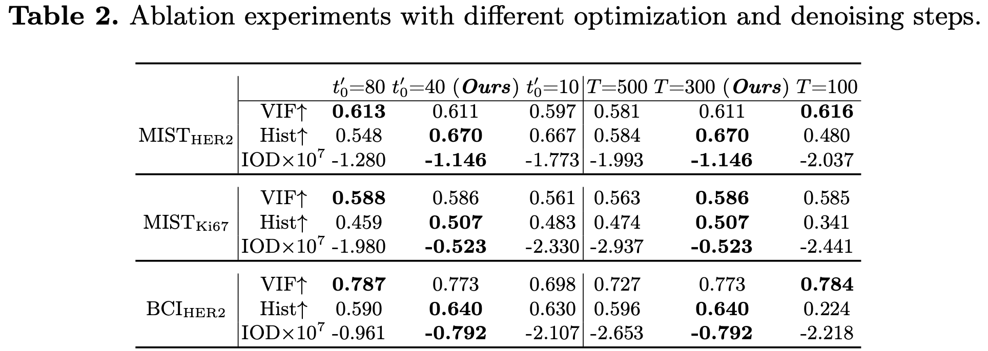
Ablation Study

Slide 11
Conclusion & Future Work
Conclusion
Novel Framework: First MI-guided energy diffusion model for unpaired virtual staining
Dynamic Disentanglement: Adaptive separation of staining style and tissue structure
Controllable Generation: Timestep-customized reverse diffusion process
Structural Consistency: Local MI-driven contrastive learning for cellular alignment
Future Work
Extension to other staining modalities
Multiplexing virtual staining
3D tissue volume staining

Slide 12
Thank you
Q&A

